Slide 1

HYD 5
Near Real Time Stock Ticker
21-06-2017
Honeywell Internal

Slide 2


Slide 3
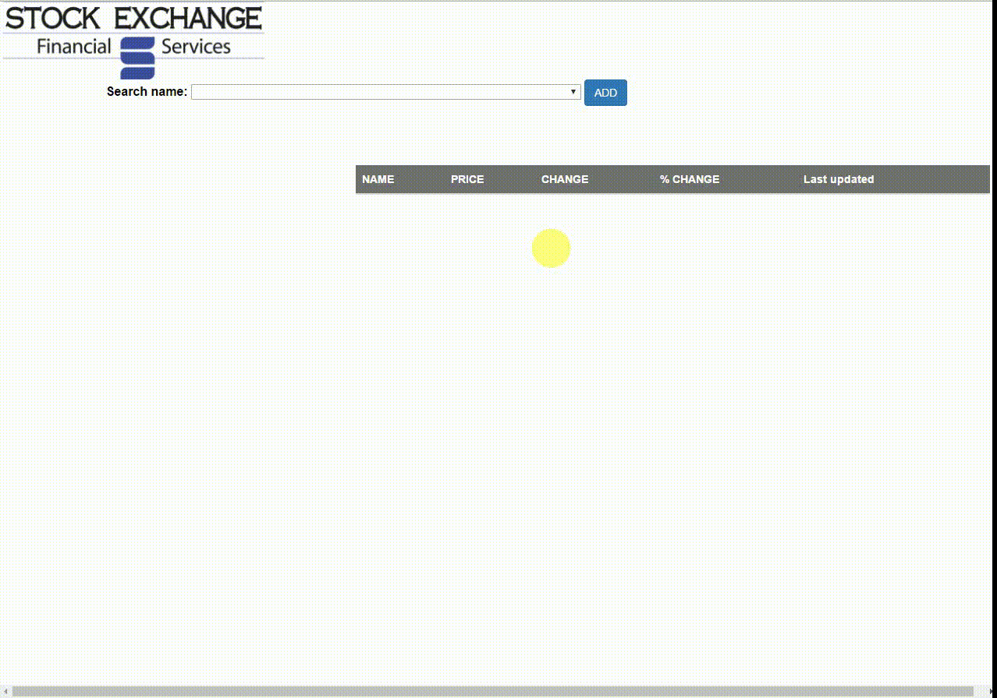

Slide 4
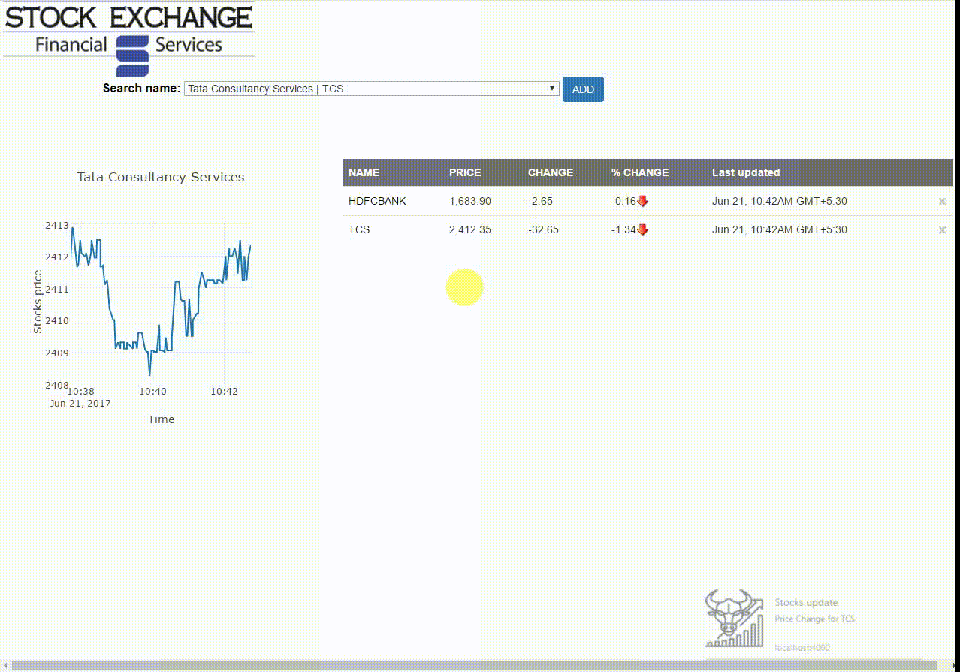

Slide 5
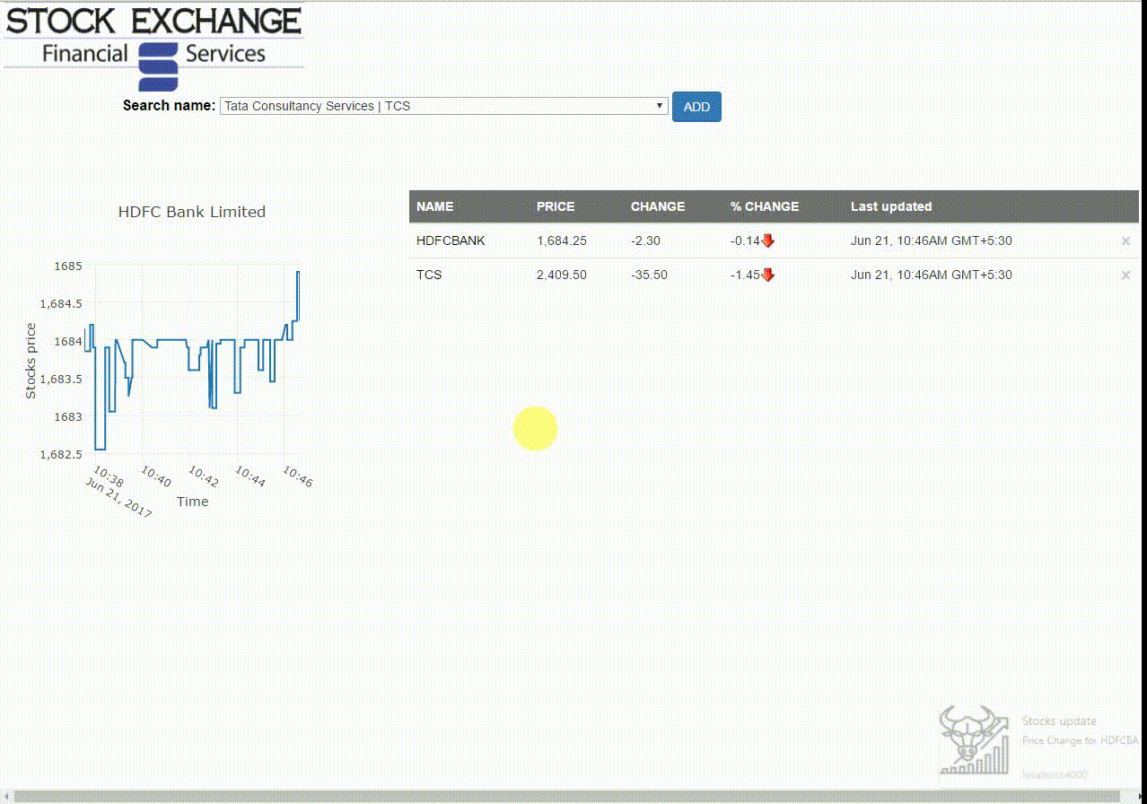

Slide 6
